Slide 1
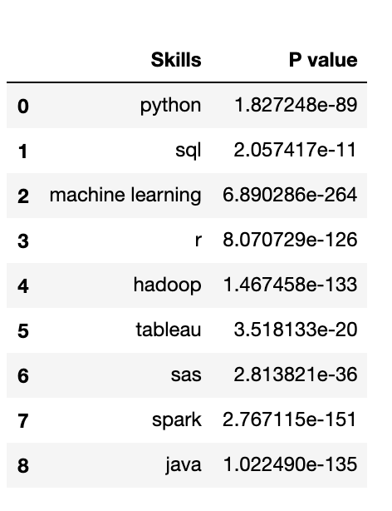
Job type v.s. skills
Job Type
Data Analyst, Data Engineer, Data Scientist
Skills of Interest
Programming Language: Python, Java
Data Base: SQL
Statistics: R, SAS, Machine Learning
Visualization: Tableau
Computing Framework: Hadoop, Spark
Data Cleaning
Python Pandas
Data Analysis
Chi-square Test

Slide 2
Cont’d
Job Type | Skills
Data Analyst | python | SQL | R | Tableau
Data Engineer | python | SQL | Hadoop | Spark | Java
Data Scientist | python | SQL | R | Machine Learning

Slide 3
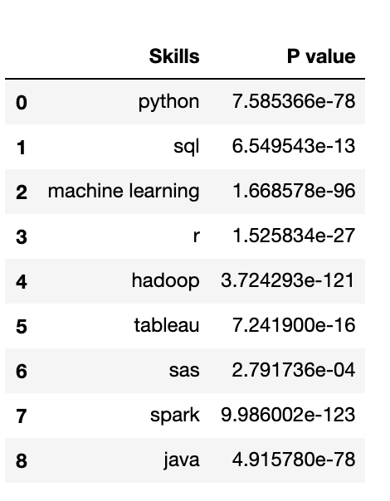
Salary v.s. skills
Salary Category
<80000, 80000-99999,
100000-119999, 120000-139999, 140000-159999
>1600000
Skills of Interest
Programming Language: Python, Java
Data Base: SQL
Statistics: R, SAS, Machine Learning
Visualization: Tableau
Computing Framework: Hadoop, Spark
Data Cleaning
Python Pandas
Data Analysis
Chi-square Test

Slide 4
CONT’D
Skills Worth Investing: Python, Spark, Java, Hadoop, Machine Learning
Essential Skills: SQL, R, Tableau, SAS

